Slide 1
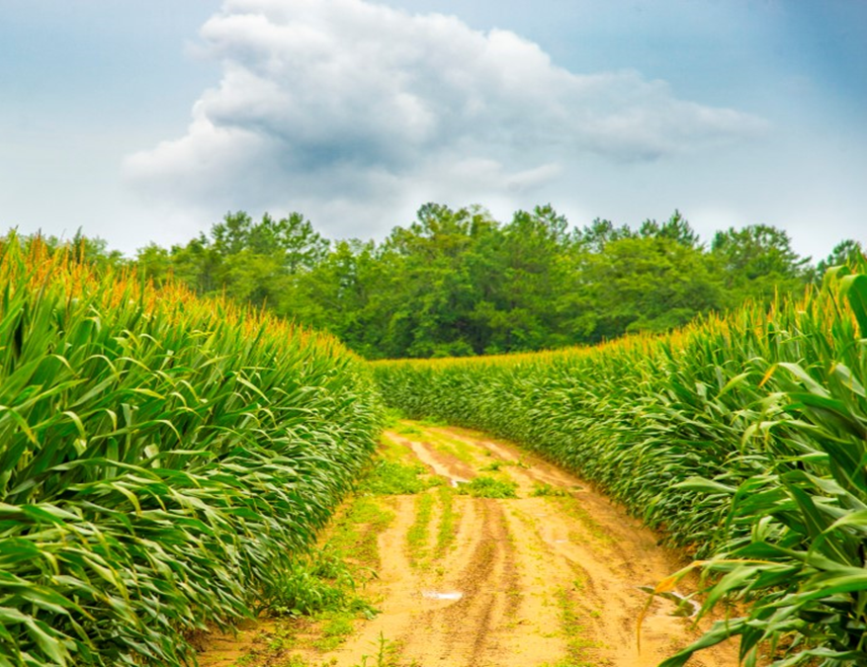
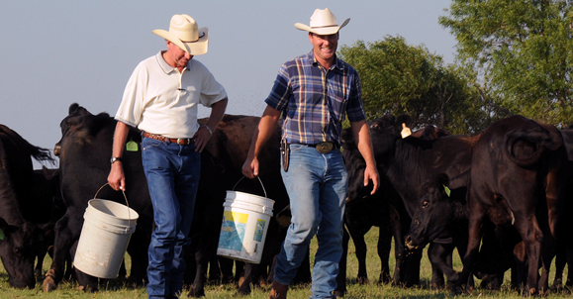
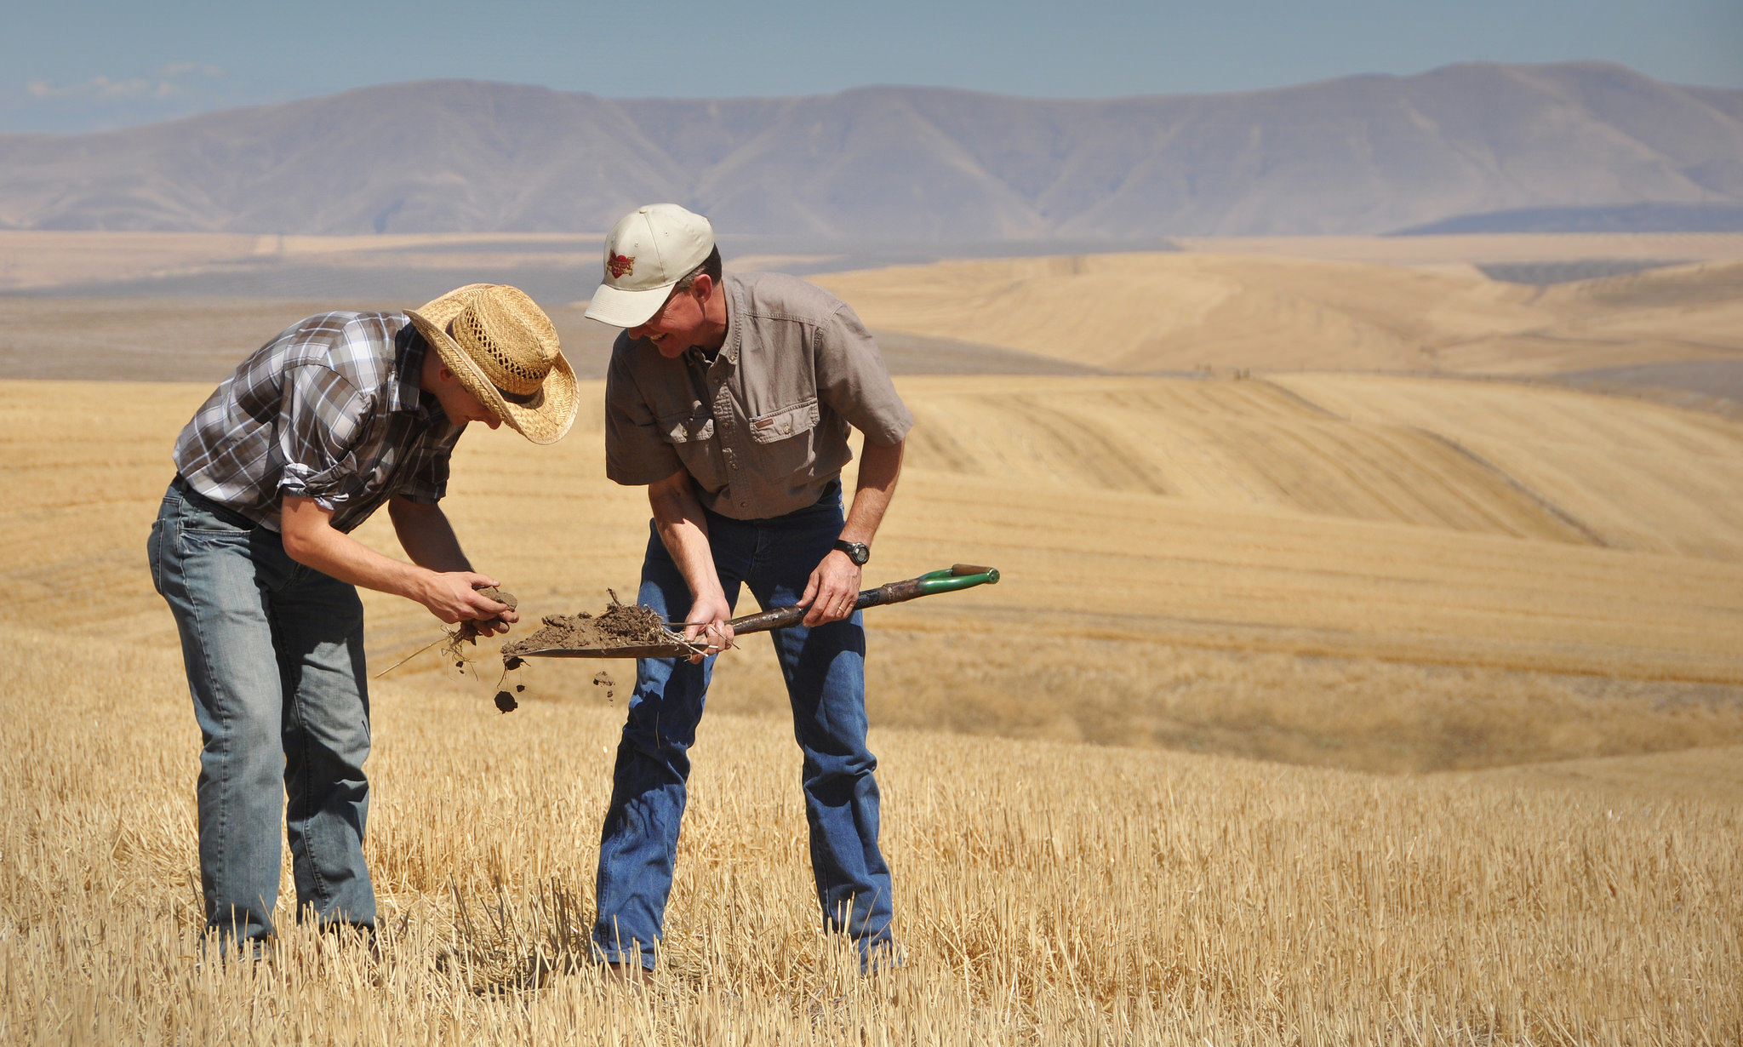
Dynamic Soil Properties (DSP) EDAPT Pilot – 1/25/2021

Slide 2
DSP Background and Business Need
The Dynamic Soil Properties (DSP) project is an effort to meet a Congressional mandate to demonstrate beneficial outcomes from Conservation Innovation Grants
Soil, water, climate, and other authoritative data sources need to be collected in a Dynamic Soil Properties (DSP) database and will include soil health field and laboratory metrics, operational outcomes, and land use and management information and the data will include both tabular and spatial data on a large scale
DSP will aggregate authoritative data sources that can impact conservation practice outcomes and conduct a covariable analysis using machine learning, statistical tools, and analytics to determine which variables influenced the outcomes
The algorithms and models developed during the analysis will be used to predict the outcomes of conservation practices on new larger geographies
As an example, soil attributes like slope, water table depth, and climate information like precipitation influence soil biology (Ex. carbon content) as well as conservation practices like cover crops and crop rotation

Slide 3
DSP EDAPT Pilot
While the planning of an EDAPT/DSP pilot hasn’t started, we need to plan an EDAPT/DSP pilot to address key challenges including:
Easy ingestion of multiple, large authoritative datasets with the ability to transform and re-aggregate
DSP Data Hub includes tabular and spatial data is expected to grow to up to several PBs (10m scale raster of 200 covariables at the National level is estimated to be 500GB) and will contain trillions of records of data
DSP requires a computational engine with machine learning, statistical tools, and analytics that can process trillions of calculations per hour with constant data visualization so that progress in processing is transparent (application instrumentation)
Due to the large, complex calculation needs, DSP computational engine is required to run server side at the Operating System level so that new models can use new tools if needed (analytic tools on client-side would not meet transactional volume nor handle the size of the data). Additionally, the DSP Data Hub will provide analysis to build models for problems not yet defined so DSP requires versatility (swiss army knife)
DSP requires a dedicated tabular and spatial development database that can be administered by end users with operating system privileges as a working area to support experimentation and development of DSP algorithms and models to predict outcomes under conservation practices
DSP requires a user interface and automation to reduce manual work interacting with multiple disparate tools (platform to tie everything together)

Slide 4
DSP Future State Requirements
Database
Ability to aggregate and store raw data from disparate authoritative data sources
Ability to transform data into analytic structures including capturing time series data
Interactive relational database storing soil properties, location, field management information, and metadata over time with integrated version control for the data
Ability to capture spatial and temporal elements
Outcomes including measures like production/yield as well as economic and social outcomes
Spatial maps with predicted properties under variable land management scenarios
Tabular and spatial Soil Health indicator potentials
Website Development
User interface to input and data curation to gather dynamic soil properties with choice lists that guide users to use the same terminology

Slide 5
DSP Future State Requirements
Data Linkages
NASIS/SSURGO - soil attributes
CR-LMOD – current and historical land use, management and operation
CD-NPAD - conservation plans and conservation practices
EDIT – description of ecological sites, including state and transition models
SCAN - soil climate monitoring program
Reporting and Analytics
Calculated and derived fields to aid in aggregation and reporting
Maintain flexibility to use SQL
Statistical analytic tools for sophisticated analysis
Machine Learning for covariable analysis and predictive engine
Reporting for providing an export of the data
Data visualization

